Slide 1
Introduction To SQL

Slide 2
SQL Statement Basics-
They are not case-sensitive
SQL statements can be separated into multiple lines
Keywords cannot be abbreviated or split
SQL statements can be terminated by semicolon(;) or forward slash(/)sign

Slide 3
Data Types
DATA TYPE | DESCRIPTION
VARCHAR(size) | Variable Length Character data
CHAR(size) | Fixed-Length Character data
NUMBER(p, s) | Variable Length Numeric Data
DATE | Date-Time Value. DD-MM-YYYY
LONG | Variable Length Character Data(Upto 2GB)
RAW AND LONG RAW | Raw Binary Data
BLOB | Maximum Size is(4 gigabytes-1)*(DB_Block_size initialization parameter(8TB to 128TB)
CLOB | Maximum size is(4gb-1)*(DB_Block_size)
BFILE | Binary data stored in an external file(upto 4GB)
ROWID | A base 64 number system representing the unique address of a row in its table.

Slide 4
Basic query statements :
Syntax to retrieve all attributes from table :
select * from table_name;
eg. SELECT * from student_details;
Syntax to retrieve specific attributes from table :
select column_name1,column_name2, … column_name from table_name;
Eg. SELECT first_name, last_name
FROM student_details;

Slide 5
Syntax to list only those records from table which satisfy the given predicate(condition) :
select columnname1,columnname2
from tablename
where search condition;
eg. Select first_name,last_name,job_id
from employees
where job_id=‘IT_PROG’ ;

Slide 6
Syntax to list distinct values in the column :
It eliminates duplicate rows
select distinct attribute name
from tablename;
eg. Select distinct job_id from employees;
select distinct job_id,department_id from employees;
Here, it will work for distinct combination of job_id and department_id

Slide 7
View Table Definition- DESCRIBE/DESC
Count Number Of Rows- *
NULL Value- NULL

Slide 8
Row Restriction
Restricting Rows Using WHERE Clause
Restricting Rows Using Comparison Operators
Restricting Rows Using SQL Operators
Restricting Rows Using Logical Operators
LIKE Operator
Working with NULL data
Sorting Data

Slide 9
Restricting Rows Using WHERE Clause SQL clauses :
It filters the records. It returns only those queries which fulfill the specific conditions.
WHERE clause is used in SELECT, UPDATE, DELETE statement etc.
Syntax
SELECT column1, column 2, ... column n
FROM table_name
WHERE [conditions]

Slide 10
WHERE clause uses some comparison operators
=equal
>greater than
<less than
>=greater than or equal
<=less than or equal
< >not equal to (or !=)

Slide 11
Restricting Rows Using Sql Operators
Using Between….AND Condition :
Displays rows that are between specified range of values
Syntax
SELECT column FROM table WHERE condition BETWEEN condition;
Eg :
SELECT name, salary FROM employee WHERE salary BETWEEN 2000 AND 3000;

Slide 12
Using IN Condition :
Displays the rows that are in matching in the list
Syntax
SELECT column FROM table WHERE condition IN(values);
Example:
SELECT ename, salary FROM employee WHERE dept_no IN(90,30,60);

Slide 13
SQL AND
The SQL AND condition is used in SQL query to create two or more conditions to be met.
It is used in SQL SELECT, INSERT, UPDATE and DELETE
Used to give more than one condition in where clause
Syntax for SQL AND:
SELECT columns FROM tables WHERE condition 1 AND condition 2;
SELECT * FROM emp WHERE Department = ’IT’ AND Location = ’Chennai’;

Slide 14
SQL OR
The SQL OR condition is used in SQL query to create a SQL statement where records are returned when any one condition met.
It can be used in a SELECT statement , INSERT statement, UPDATE statement or DELETE statement.
Syntax : SELECT columns FROM tables WHERE condition1 OR condition 2;

Slide 15
SQL NOT
Used for negate condition
Eg.
Select last_name, job_id, salary from employees WHERE salary > 10000 AND job_id NOT IN(‘SA_MAN’, ‘SA_REP’);

Slide 16
Restricting Rows Using LIKE operator :
Used for inexact searches
Use wildcard searches
% : Match any number of character including 0
or more
_ : Match exactly one character
Examples :
Select * from employees where first_name like ‘_r%’;

Slide 17
IS NULL /IS NOT NULL
Used to find null values in a table
Examples:
Select * from employees where manager_id IS NULL;
Select * from employees where manager_id IS NOT NULL;

Slide 18
Order By Clause
It changes returning rows order by any column or alias or numeric position of column in select list
SELECT column1,column2,…column n FROM table_name WHERE condition ORDER BY columnname,[columnname];
Order By Using Given Alias

Slide 19
Order by using column position in select list or column order in database
Order multiple columns
ASC ,DESC order

Slide 20
ROWID
Unique identifier that contains physical address of row.
Automatically generated at the time of insertion of row
Fastest way to acess single row using it’s ROWID
It is permanent

Slide 21
ROWNUM
It is consecutive logical sequence number given to row
Fetched from table
It’s temporary

Slide 22
Functions
A function is a bunch of code created for reuse.
In oracle database functions are classified into
Single Row Function
Multiple Row Function
Syntax:
Function_name(argument1, argument2)

Slide 23
Single Row Function/Scalar Funcion
Operates on one row and returns only one result per row of a queried table.
Accept one or more arguments and return only one value
A column or expression can be use as a argument
Used with select, where, order by clause

Slide 24
Types of Single Row Functions
Character Function
Number Function
Date Function
Conversion Function

Slide 25
Dual Table :
- It is sort of dummy table.
- Its a real table but never gets updated.
- It exists in every oracle database.
- useful for troubleshooting and development.
query : select * from dual;
o/p: D
-
X
It can be used by any user. As it contains one row only , used to return single result.
Eg. select sysdate from dual;

Slide 26
Character Function
It takes charachter as input and return character or numeric data as output
Case Conversion Function
Character manipulation Function
Case Conversion Function
UPPER function
LOWER Function
INITCAP Function

Slide 27
Character Manipulation Function
Substring
To Find substring of a column data
Syntax
SUBSTR(column_name, start_position, length)
LENGTH
To find a length of a string
Syntax
LENGTH(column_name)

Slide 28
Concate function
To merge two or more input string or to connect two or more columns as a single column
Syntax
CONCAT(string1,string2)
INSTR Function
INSTR(string,substring[,position,occurrence])

Slide 29
Trim Function
To trim spaces or character from starting and ending point of string
Syntax
TRIM([[LEADING|TRAILING|BOTH] trim_character from] string);

Slide 30
LTRIM(‘string’, ’string to trim’);
RTRIM (‘string’, ’string to trim’);
LPAD(‘string’, length, character to pad);
RPAD(‘string’, length, character to pad);
REPLACE(string, string_to_replace, replacement_string);
REVERSE(‘string’);

Slide 31
Numeric Function:
ROUND(): To round a given number to the nearest integer or to a certain decimal place.
syntax : ROUND(number , decimal)
eg : round(23.458798,2) 23.46
TRUNC() : Truncates values to the specified number of decimal places.
syntax : TRUNC(number , decimal)
eg. trunc(23.458798,2) 23.45

Slide 32
MOD() : Returns remainder of division
syntax : MOD(m,n) eg.mod(1700,500) 200
CEIL() : Returns highest integer number greater than or equal to a specified number.
syntax: CEIL(number) eg. CEIL(69.5678) 70
FLOOR() : Returns lowest integer number less than or equal to a specified number.
Syntax : FLOOR(number) eg. Floor(234.678) 234

Slide 33
POWER: Finds out nth power of the number
Syntax : power(number , n) eg. Power(3,3) 27
SQRT : Finds square root of number.
syntax : sqrt(number) eg . sqrt(64) 8

Slide 34
Oracle Date Functions :
SYSDATE : Returns the current date of the OS where oracle database is installed.
CURRENT_DATE: Returns the current date of the place where the user’s session is logged in from.
SESSIONTIMEZONE : Returns time zone of the user’s session.
SYSTIMESTAMP : Returns the date and time of the database.
CURRENT_TIMESTAMP : Returns current date and time from user’s session.

Slide 35
Date Manipulation Function :
ADD_MONTHS(date,n)
Adds months to a date
MONTHS_BETWEEN(DATE1,DATE2)
ROUND(date,format)
EXTRACT(date_component from date)
TRUNC(date,format)
NEXT_DAY(date,day of week)
LAST_DAY(date)

Slide 36
Conversion Functions
Used to convert one data type into another
Implicit Data Type Conversion
Oracle server automatically converts some data type to the required one.
Implicit Conversion
FROM | TO
VARCHAR OR CHAR | NUMBER
VARCHAR OR CHAR | DATE
NUMBER | VARCAHR
DATE | VARCAHR

Slide 37
Explicit Data Type Conversion
Explicit conversions are done using the conversion functions explicitly.
Explicit conversion function
TO_CHAR( )
TO_NUMBER( )
TO_DATE( )

Slide 38
TO_CHAR( ): Converts number or date to varchar datatype in a specified format model.
Syntax : TO_CHAR(date|number, format_model, nls_parameter)

Slide 39
Date Format Models
YYYY | YY | YEAR | MM | MON | MONTH | DD | DAY | DY
HH | MI | SS | DD | DDTH | DDSPTH | MMTH | MMSPTH

Slide 40
Number Format Models
9 Specifies number of digits
0 Specifies leading and trailing zero
$ Adds dollar sign
L Display local currency symbol
. Display decimal point (period)
, Display comma as indicator

Slide 41
TO_NUMBER( ) : Convert character data to number data type.
Syntax : TO_NUMBER(character, format_model)
TO_DATE( ) : Convert character data to date data type.
Syntax : TO_DATE(Character, format_model)

Slide 42
NULL Related functions
NVL
Performing some operation with null results in null. To handle these situation NVL function is used.
syntax : NVL(Expression 1, Expression 2)
If expression 1 null then NVL function return expression 2 else return expression 1.
Useful in arithmetic operation to avoid calculation errors.

Slide 43
NVL2 Function
The NVL2 allows us replace a value when a NULL value is encountered as well as when NON-NULL value is encountered.
NVL2(Expression 1, Expression 2, Expression 3)
If expression 1 is NOT NULL then return expression 2.
If expression 1 is NULL then return expression 3

Slide 44
NULLIF Function
Compares expression 1 and expression 2 if they are same return NULL. But if they are not equal returns expression 1
Expression 1 and expression 2 must be in same data type.

Slide 45
COALESCE Function
It accepts list of arguments and returns the first one that evaluates to a NON-NULL value.
COALESCE( Expression 1, Expression 2,…..Expression N)
All of expressions must be in same datatype.

Slide 46
Condition Expression
DECODE FUNCTION
Specific to oracle
It is used to provide IF-THEN_ELSE logic in SQL.
Syntax :
DECODE(column/expression,search1,result1,search2,result 2,default)

Slide 47
Multiple Row Functions/Aggregate functions :
Group Function
It process on multiple values and give one output
Used after select keyword
Group functions ignore null values
DISTINCT and ALL keyword used with group function

Slide 48
Average Function
Used to getting average value of column or expression
Used with numeric data
Syntax
AVG(expression\column name)

Slide 49
COUNT Function
Count the number of returning rows
Syntax :
COUNT(column name)
MAX Function
Returns maximum value of an expression or column
Syntax:
MAX(column\Expression)

Slide 50
MIN Function
Returns minimum values of column or expression
Used with numeric, character, date datatype
Syntax :
MIN(Expression)

Slide 51
SUM Function
Used for getting sum of the column or expression you provide with it.
Syntax:
SUM(all/distinct expression)
Used with numeric data

Slide 52
LISTAGG Function
Used to aggregate strings from data in column in a database table
Concates values from separate rows into single value
Transforms data from multiple rows into a single list of values separated by specified delimiter.
Syntax :
LISTAGG(column name[,delimeter] within group order by [sort-expression])

Slide 53
GROUP BY CLAUSE :
Creates groups of values using group function.
Syntax :
SELECT exp1,exp2,…..,expN
Aggregate function(aggregate expression)
FROM table
WHERE condition
GROUP BYexp1, exp2,….expN
ORDER BY order-expression;

Slide 54
Having Clause
The group function cannot be used in where clause
We can use having clause to filter data after it has been grouped
The where clause filters the rows whereas having clause filters grouped data
Syntax
SELECT column name, group function
FROM table
WHERE condition
GROUP BY group by expression
HAVING group condition
ORDER BY column;

Slide 55
While writing we have to maintain the sequence
as :
From-->where --> group by --> having --> order by-->
Execution occurs :
From->where->group by->having->select->distinct->order by->limit

Slide 56
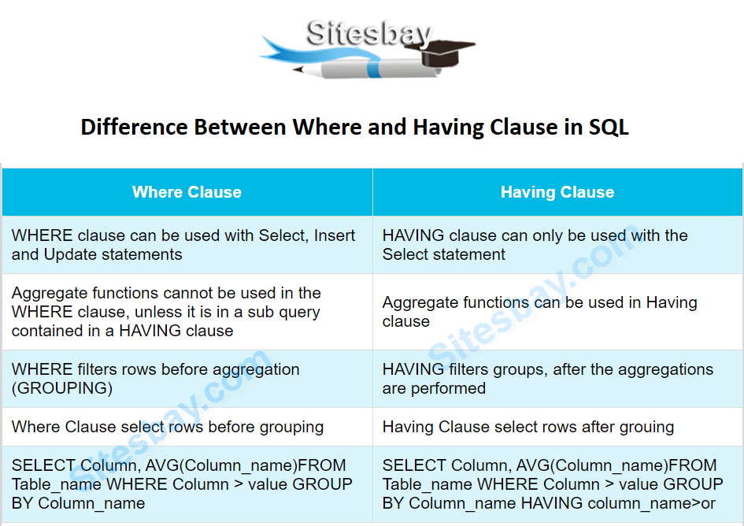
Difference between HAVING and WHERE Clause

Slide 57
Join :
A join is a concept allows us to retrieve data from two or more tables in a single query.
In SQL, we often need to write queries to get data from two or more tables .To get data from multiple tables we need to use the joins.
Join: joins two tables based on a common column, and selects records that have matching values in these columns.
Join has different types :
Natural Join
Inner Join
Outer Join
EquiJoin
Self Join

Slide 58
General syntax of join is:
SELECT columns FROM table1 JOIN table2 ON table1.column_name=table2.column_name
Ex: SELECT Customers.customer_id, Customers.first_name, Orders.amount
FROM Customers JOIN Orders ON Customers.customer_id = Orders.customer;

Slide 59
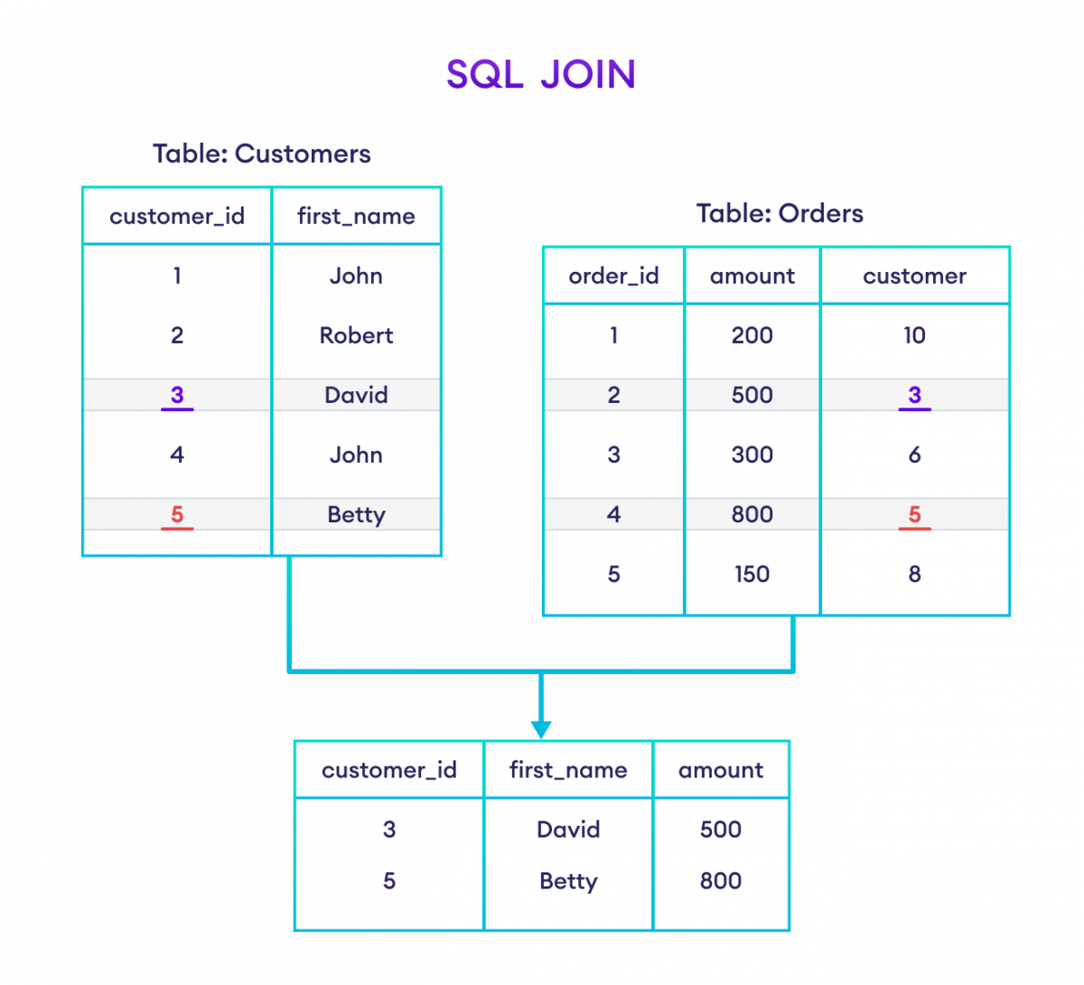

Slide 60
Natural Join :
Implicitly joins two tables based on common columns that have same name and same datatype.
Syntax
SELECT column FROM table1 NATURAL JOIN table2;

Slide 61
EQUIJOIN :
When joining two tables,if there are more than one common column that have same names,we can use the using clause to specify which columns needs to be selected as join column in join operation.
The using clause is used for mathching a specific column when joining two tables.
Syntax :
SELECT column from table1 JOIN table 2 USING (column_name);

Slide 62
NON-EQUIJOIN :
SELECT Customers.customer_id, Customers.first_name, Orders.amount
FROM Customers
INNER JOIN Orders
ON Customers.customer_id = Orders.customer
WHERE Orders.amount >= 500;

Slide 63
INNER JOIN :
Returns all rows from both the participating tables that satisfy join condition or expression of the ON /USING clause
Unmatch rows are not return
Syntax :
SELECT column FROM table1 INNER JOIN table2 ON(join condition)/USING (column name);

Slide 64
SELF JOIN :
Joining table with itself
A self join is used for compairing rows in the same table or querying hierarchical table.

Slide 65
OUTER JOIN :
Outer joins returns thematching rows from joined tables plus unmatched rows from one or both tables.
It has three types
LEFT OUTER JOIN
RIGHT OUTER JOIN
FULL OUTER JOIN

Slide 66
LEFT OUTER JOIN : Left outer join returns all matching rows of both tables and the unmatched rows of left table for unmatched rows,the column values of other table are shown as null.
Syntax
SELECT column FROM table1 LEFT OUTER JOIN table2 ON(join condition)/USING (column name);

Slide 67
RIGHT OUTER JOIN : Right outer join returns all the matching rows of both tables and the unmatched rows of right table. For unmatched rows,the column values of the other table are shown as null.
Syntax :
SELECT column FROM table1 RIGHT OUTER JOIN table2 ON(join condition)/USING (column name);

Slide 68
FULL OUTER JOIN: Retrieves all of the rows from both tables if match is found, then it displays the matching rows if not, it displays null values.
Syntax :
SELECT column FROM table1 FULL OUTER JOIN table2 ON(join condition)/USING (column name);

Slide 69
Constraints
Constraints restrict data entry (insert, update, delete) and prevent invalid entries
Constraints prevent dropping dependent tables
Constraints ensure data consistency and data integrity in database.
Constraints increase control of the user over data
It has different types
NOT NULL Constraint
UNIQUE Constraint
Primary Key
Foreign Key
Check Constraint

Slide 70
We can add constraints while creating table or we can add them later on.
Constraints can be at column level or table level
The function of the table and column level constraints is same

Slide 71
NOT NULL Constraints
NOT NULL constraints prevent the insertion of NULL values into column
NOT NULL constraints can only be created at column level
Example
CREATE table manager
(manager_id number NOT NULL,
first_name varchar(20),
Last_name varchar(20) constraint lname_not_null NOT NULL,
Dept_id number NOT NULL
);

Slide 72
UNIQUE Constraint
Unique constraint ensures the uniqueness of column or set of columns which means no duplicate values will be inserted.
Unique constraint can be created on multiple columns called composite unique constraints.
Example
CREATE table manager
(employee_id number,
first_name varchar(50) UNIQUE,
last_name varchar(50) constraint lname_uk UNIQUE,
Department_id number not null,
Phone_number varchar(20)
CONSTRAINT dept_uk UNIQUE(department_id)
CONSTRAINT composite_uk UNIQUE(employee_id,first_name,last_name)
);

Slide 73
UPDATE Records
Use when we want to modify existing records in a table.
Syntax:
UPDATE table_name SET column1=value1, column2=value2 where condition;

Slide 74
Delete Records
Delete row in table
Syntax-
DELETE FROM table_name where condition;

Slide 75
Having clause
The HAVING clause places the condition in the groups defined by the GROUP BY clause in the SELECT statement.

Slide 76
Syntax
SELECT column_Name1, column_Name2, ....., column_NameN aggregate_function_name(column_Name) FROM table_name GROUP BY column_Name1 HAVING condition;
suppose that you want to show those cities whose total salary of employees is more than 5000. For this case, you have to type the following query with the HAVING clause in SQL:
SELECT SUM(Emp_Salary), Emp_City FROM Employee GROUP BY Emp_City HAVING SUM(Emp_Salary)

Slide 77
SQL ORDER BY Clause
Using the ORDER BY clause, we can sort the records in ascending or descending order as per our requirement. The records will be sorted in ascending order whenever the ASC keyword is used with ORDER by clause. DESC keyword will sort the records in descending order.
Syntax
SELECT ColumnName1,...,ColumnNameN FROM TableName ORDER BY ColumnName ASC;
SELECT ColumnName1,...,ColumnNameN FROM TableName ORDER BY ColumnName DESC;

